Slide 1
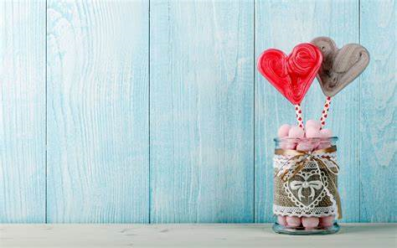
GIFT YOUR LOVED ONES
Login
User name:
Password:
Login
Forget password?

Slide 2

GIFT YOUR LOVED ONES
Gifts
Bouquet
Chocolates
Hampers

Slide 3
GIFT YOUR LOVED ONES
Product name:
Add

Slide 4
GIFT YOUR LOVED ONES
Product has been added

Slide 5
GIFT YOUR LOVED ONES
Gifts
Bouquet
Chocolates
Hampers

Slide 6

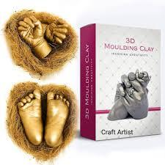

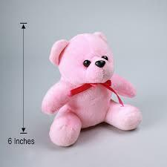
GIFT YOUR LOVED ONES
Secret Temptation
Perfume
M.R.P
350/-
Gold moulding
Powder
M.R.P
800/-
Photo Frame
M.R.P
1000/-
Teddy Bear
M.R.P
800/-
Notes:
User want to select secret perfume it will read to next page

Slide 7
GIFT YOUR LOVED ONES
Item image:
Title:
Description:
M.R.P:
Add

Slide 8
GIFT YOUR LOVED ONES
Item has been added

Slide 9
GIFT YOUR LOVED ONES
Secret Temptation
Perfume
M.R.P
350/-
Gold moulding
Powder
M.R.P
800/-
Photo Frame
M.R.P
1000/-
Teddy Bear
M.R.P
800/-
Notes:
User want to select secret perfume it will read to next page

Slide 10

GIFT YOUR LOVED ONES
Secret Temptation Perfume
Secret temptation Dream eau de perfume for unisex
50ml premium long-lasting luxury perfume
Ideal for office wear
Add to cart
Notes:
User want to select secret perfume it will read to next page

Slide 11
GIFT YOUR LOVED ONES
Secret Temptation Perfume
RS:350/-
Buy now
Notes:
User want to select secret perfume it will read to next page

Slide 12
GIFT YOUR LOVED ONES
Your order has been placed
Notes:
User want to select secret perfume it will read to next page

Slide 13
GIFT YOUR LOVED ONES
Gold moulding Powder
Ditya Crafts 3D Moulding powder kit
Add to cart
Add to cart
Notes:
By clicking moulding it will read to the next page

Slide 14
GIFT YOUR LOVED ONES
Gold moulding Powder
RS:800
Add to cart
Buy now
Notes:
By clicking moulding it will read to the next page

Slide 15
GIFT YOUR LOVED ONES
Heart shape Photo Frame
Customized heart shape photo collage ideal for gift in family weeding and couple photo cut out frame Home wall art décor gift
(frame size 20*20 inch)multi colour
Add to cart
Add to cart
Notes:
User want to photo frame it will move to photo frame page

Slide 16
GIFT YOUR LOVED ONES
Heart shape Photo Frame
RS:1000/-
Add to cart
Buy now
Notes:
User want to photo frame it will move to photo frame page

Slide 17
GIFT YOUR LOVED ONES
Teddy Bear
Teddy bear for girl soft stuffed lovable non-toxic fabric(6feet)
Add to cart
Add to cart
Notes:
By clicking teddy it will move to next page

Slide 18
GIFT YOUR LOVED ONES
Teddy Bear
RS:800/-
Add to cart
Buy now
Notes:
By clicking teddy it will move to next page

Slide 19

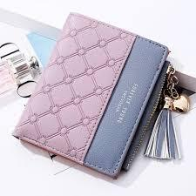
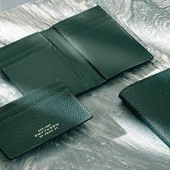
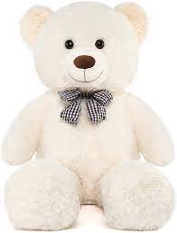
GIFT YOUR LOVED ONES
Bellavita
perfume
M.R.P
450/-
Fashion women
wallet
M.R.P
350/-
Best wallet for men
M.R.P
250/-
Teddy Bear
M.R.P
850/-

Slide 20
GIFT YOUR LOVED ONES
Bellavita perfume Gift set
Bellavita organic luxury unisex perfume gift set 4*20ml eau de perfume-80ml
Add
Add to cart

Slide 21
GIFT YOUR LOVED ONES
Bellavita perfume Gift set
Rs:450/-
Add
Buy now

Slide 22
GIFT YOUR LOVED ONES
Fashion women wallet
Fashion women wallet with wristlet
Add
Add to cart

Slide 23
GIFT YOUR LOVED ONES
Fashion women wallet
RS:350/-
Add
Buy now

Slide 24
GIFT YOUR LOVED ONES
Best wallet for men
Men formal brown genuine leather rfid wallet(7 card slot)
Add
Add to cart

Slide 25
GIFT YOUR LOVED ONES
Best wallet for men
RS:350/-
Add
Buy now

Slide 26
GIFT YOUR LOVED ONES
Teddy Bear
Teddy bear for girl soft stuffed lovable non-toxic fabric(9feet)
Add
Add to cart

Slide 27
GIFT YOUR LOVED ONES
Teddy Bear
RS:850/-
Add
Buy now

Slide 28
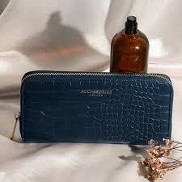
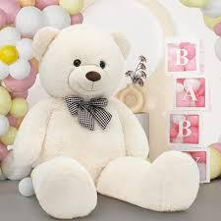
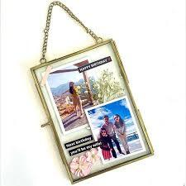
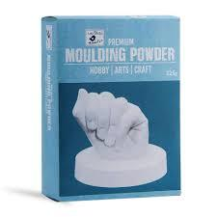
GIFT YOUR LOVED ONES
Ladies wallet
M.R.P
350/-
Bigg teddy bear
M.R.P
3050/-
Glass photo frame
M.R.P
750/-
White birdic
Premium moulding
powder
M.R.P
450/-

Slide 29
GIFT YOUR LOVED ONES
Ladies wallet
Womens kami multi utility mobile wallet Detachable sling strap
Add
Add to cart

Slide 30
GIFT YOUR LOVED ONES
Ladies wallet
RS:350/-
Add
Buy now

Slide 31
GIFT YOUR LOVED ONES
Bigg teddy bear
Teddy bear for girl soft stuffed lovable non-toxic fabric(17feet)
Add
Add to cart

Slide 32
GIFT YOUR LOVED ONES
Bigg teddy bear
RS:3050/-
Add
Buy now

Slide 33
GIFT YOUR LOVED ONES
Glass photo frame
Mahogamy life vintage glass hanging rectangular photo frame for wall décor(5*7)
Add
Add to cart

Slide 34
GIFT YOUR LOVED ONES
Glass photo frame
RS:750/-
Add
Buy now

Slide 35
GIFT YOUR LOVED ONES
White moulding powder
Ditya crafts 3D moulding powder kit
Add
Add to cart

Slide 36
GIFT YOUR LOVED ONES
White moulding powder
RS:450/-
Add
Buy now

Slide 37

GIFT YOUR LOVED ONES
Tree photo frame
M.R.P
600/-

Slide 38
GIFT YOUR LOVED ONES
Tree photo frame
Wooden family collage photo frame for birthday gift, anniversary gift, (8 images, wooden finish,size-23.5*23.5 inch)
Add
Add to cart

Slide 39
GIFT YOUR LOVED ONES
Tree photo frame
RS:600/-
Add
Buy now

Slide 40
GIFT YOUR LOVED ONES
Gifts
Bouquet
Chocolates
Hampers

Slide 41
GIFT YOUR LOVED ONES
Single
Medium
Large
Medium

Slide 42

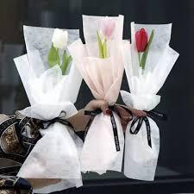
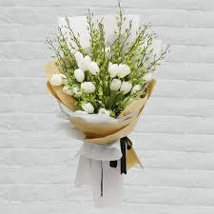
GIFT YOUR LOVED ONES
Single Red Rose
M.R.P
30/-
Single Tulip
M.R.P
100/-
Single Gardenia
M.R.P
80/-

Slide 43
GIFT YOUR LOVED ONES
Item image:
Title:
Description:
M.R.P:
Add

Slide 44
GIFT YOUR LOVED ONES
Item has been added

Slide 45
GIFT YOUR LOVED ONES
Single Red Rose
M.R.P
30/-
Single Tulip
M.R.P
100/-
Single Gardenia
M.R.P
80/-

Slide 46
GIFT YOUR LOVED ONES
Red Rose
Single red rose flower
bouquet
Add to cart

Slide 47
GIFT YOUR LOVED ONES
Single Red Rose
RS:30/-
Buy now

Slide 48
GIFT YOUR LOVED ONES
Your order has been placed
Notes:
User want to select secret perfume it will read to next page

Slide 49
GIFT YOUR LOVED ONES
Single Tulip flower
Single white color, red color and pink color tulip flower bouquet
Add to cart

Slide 50
GIFT YOUR LOVED ONES
Single Tulip flower
RS:100/-
Buy now

Slide 51
GIFT YOUR LOVED ONES
Single gardenia bouquet
White color gardenia flower bouquet
Add to cart

Slide 52
GIFT YOUR LOVED ONES
Single gardenia bouquet
RS:80/-
Buy now

Slide 53
GIFT YOUR LOVED ONES
Single
Medium
Large
Medium

Slide 54
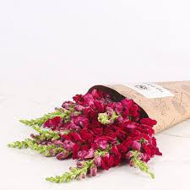

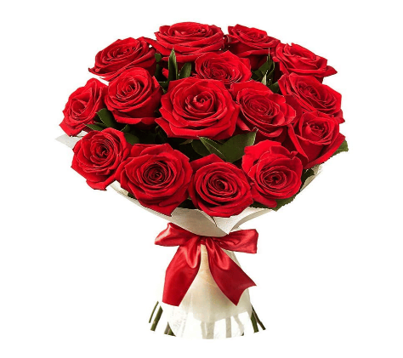


GIFT YOUR LOVED ONES
Snap drogon
M.R.P
500/-
Iris
M.R.P
300/-
Redrose
M.R.P
250/-
Tulip
M.R.P 1000/-
Lilly
M.R.P
180/-
Gardenia
M.R.P
800/-

Slide 55
GIFT YOUR LOVED ONES
Item image:
Title:
Description:
M.R.P:
Add

Slide 56
GIFT YOUR LOVED ONES
Item has been added

Slide 57
GIFT YOUR LOVED ONES
Snap drogon
M.R.P
500/-
Iris
M.R.P
300/-
Redrose
M.R.P
250/-
Tulip
M.R.P 1000/-
Lilly
M.R.P
180/-
Gardenia
M.R.P
800/-

Slide 58
GIFT YOUR LOVED ONES
Tulip
Medium size(5ft)white tulip flower bouquet
Add to cart

Slide 59
GIFT YOUR LOVED ONES
Tulip
RS:1000/-
Buy now

Slide 60
GIFT YOUR LOVED ONES
Your order has been placed
Notes:
User want to select secret perfume it will read to next page

Slide 61
GIFT YOUR LOVED ONES
Snap dragon
Medium size(5ft) multicolor snapdragon flower bouquet
Add to cart

Slide 62
GIFT YOUR LOVED ONES
Snap dragon
RS:500/-
Buy now

Slide 63
GIFT YOUR LOVED ONES
Iris
Medium size(5ft) violet color iris flower bouquet
Add to cart

Slide 64
GIFT YOUR LOVED ONES
Iris
RS:300/-
Buy now

Slide 65
GIFT YOUR LOVED ONES
Red rose
Medium size(5ft) red rose flower bouquet
Add to cart

Slide 66
GIFT YOUR LOVED ONES
Red rose
RS:250/-
Buy now

Slide 67
GIFT YOUR LOVED ONES
Lilly
Medium size(5ft) white and pink color flower bouquet
Add to cart

Slide 68
GIFT YOUR LOVED ONES
Lilly
RS:180/-
Buy now

Slide 69
GIFT YOUR LOVED ONES
Gardenia
Medium size(5ft) white color flower bouquet
Add to cart

Slide 70
GIFT YOUR LOVED ONES
Gardenia
RS:800/-
Buy now

Slide 71
GIFT YOUR LOVED ONES
Single
Medium
Large
Medium

Slide 72


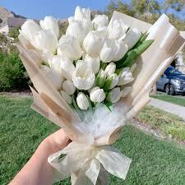

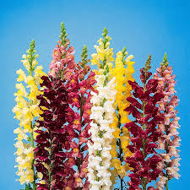
GIFT YOUR LOVED ONES
Gardenia
M.R.P
1500/-
Red Rose
M.R.P
700/-
Tulip
M.R.P
1700/-
Lilly
M.R.P
500/-
Iris
M.R.P
800/-
Snap Drag
M.R.P
1000/-

Slide 73
GIFT YOUR LOVED ONES
Item image:
Title:
Description:
M.R.P:
Add

Slide 74
GIFT YOUR LOVED ONES
Item has been added

Slide 75
GIFT YOUR LOVED ONES
Gardenia
M.R.P
1500/-
Red Rose
M.R.P
700/-
Tulip
M.R.P
1700/-
Lilly
M.R.P
500/-
Iris
M.R.P
800/-
Snap Drag
M.R.P
1000/-

Slide 76
GIFT YOUR LOVED ONES
Gardenia
Large size(5ft) white color gardenia flower bouquet
Add to cart

Slide 77
GIFT YOUR LOVED ONES
Gardenia
RS:1500/-
Buy now

Slide 78
GIFT YOUR LOVED ONES
Your order has been placed
Notes:
User want to select secret perfume it will read to next page

Slide 79
GIFT YOUR LOVED ONES
Red Rose
Large size(8ft) red rose flower bouquet
Add to cart

Slide 80
GIFT YOUR LOVED ONES
Red Rose
RS:700/-
Buy now

Slide 81
GIFT YOUR LOVED ONES
Tulip
Large size(8ft) white color tulip flower bouquet
Add to cart

Slide 82
GIFT YOUR LOVED ONES
Tulip
RS:1700/-
Buy now

Slide 83
GIFT YOUR LOVED ONES
Lilly
Large size(8ft) white and pink flower bouquet
Add to cart

Slide 84
GIFT YOUR LOVED ONES
Lilly
RS:500/-
Buy now

Slide 85
GIFT YOUR LOVED ONES
Iris
Large size (8ft) violet color iris flower bouquet
Add to cart

Slide 86
GIFT YOUR LOVED ONES
Iris
RS:800
Buy now

Slide 87
GIFT YOUR LOVED ONES
Snap Dragon
Large size (8ft) multicolor snapdragon flower bouquet
Add to cart

Slide 88
GIFT YOUR LOVED ONES
Snap Dragon
RS:1000
Buy now

Slide 89
GIFT YOUR LOVED ONES
Gifts
Bouquet
Chocolates
Hampers

Slide 90
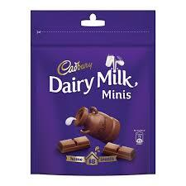
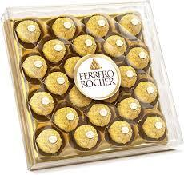
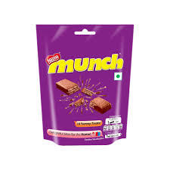
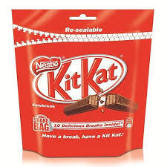


GIFT YOUR LOVED ONES
Dairy Milk
M.R.P
250/-
Ferrorocher
M.R.P
650/-
Munch
M.R.P
250/-
KitKat
M.R.P
250/-
Perk
M.R.P
250/-
5Star
M.R.P
250/-

Slide 91
GIFT YOUR LOVED ONES
Item image:
Title:
Description:
M.R.P:
Add

Slide 92
GIFT YOUR LOVED ONES
Item has been added

Slide 93
GIFT YOUR LOVED ONES
Dairy Milk
M.R.P
250/-
Ferrorocher
M.R.P
650/-
Munch
M.R.P
250/-
KitKat
M.R.P
250/-
Perk
M.R.P
250/-
5Star
M.R.P
250/-

Slide 94
GIFT YOUR LOVED ONES
Dairy Milk
Cadbury dairy milk mini pack(pack of 18)250gm
Add
Add to cart

Slide 95
GIFT YOUR LOVED ONES
Dairy Milk
RS:250/-
BAdd
Buy now

Slide 96
GIFT YOUR LOVED ONES
Your order has been placed
Notes:
User want to select secret perfume it will read to next page

Slide 97
GIFT YOUR LOVED ONES
Ferrorocher
Ferrorocher premium chocolate 24 pieces 300gm
Add
Add to cart

Slide 98
GIFT YOUR LOVED ONES
Ferrero rocher
RS:650/-
Add
Buy now

Slide 99
GIFT YOUR LOVED ONES
Munch
Nestle munch chocolatebar 202g pouch
Add
Add to cart

Slide 100
GIFT YOUR LOVED ONES
Munch
RS:250/-
Add
Buy now

Slide 101
GIFT YOUR LOVED ONES
KitKat
Kitkat nestle caramel chocolate coated waffer 50g
Add
Add to cart

Slide 102
GIFT YOUR LOVED ONES
KitKat
RS:250/-
Add
Buy now

Slide 103
GIFT YOUR LOVED ONES
Perk
Cadbury perk chocolate bar pack of 30
Add
Add to cart

Slide 104
GIFT YOUR LOVED ONES
Perk
RS:250/-
Add
Buy now

Slide 105
GIFT YOUR LOVED ONES
5Star
Cadbury 5start chocolate home treat bar 191.9gm
Add
Add to cart

Slide 106
GIFT YOUR LOVED ONES
5Star
RS:250/-
Add
Buy now

Slide 107
GIFT YOUR LOVED ONES
Gifts
Bouquet
Chocolates
Hampers

Slide 108
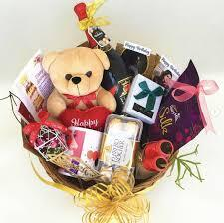
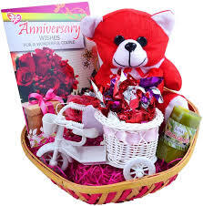
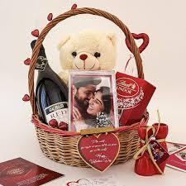
GIFT YOUR LOVED ONES
Birthday Hamper
M.R.P
1500/-
Anniversary Hamper
M.R.P
2000/-
Valentine Hamper
M.R.P
3600/-

Slide 109
GIFT YOUR LOVED ONES
Item image:
Title:
Description:
M.R.P:
Add

Slide 110
GIFT YOUR LOVED ONES
Item has been added

Slide 111
GIFT YOUR LOVED ONES
Birthday Hamper
M.R.P
1500/-
Anniversary Hamper
M.R.P
2000/-
Valentine Hamper
M.R.P
3600/-

Slide 112
GIFT YOUR LOVED ONES
Birthday Hamper
.Greeting card
.rose
.chocolate
.teddybear
Add
Add to cart

Slide 113
GIFT YOUR LOVED ONES
Birthday Hamper
RS:1500/-
Add
Buy now

Slide 114
GIFT YOUR LOVED ONES
Your order has been placed
Notes:
User want to select secret perfume it will read to next page

Slide 115
GIFT YOUR LOVED ONES
Anniversary Hamper
.Greeting card
.bouquet
.chocolates
.key chain
.bottle
Add
Add to cart

Slide 116
GIFT YOUR LOVED ONES
Anniversary Hamper
RS:2000/-
Add
Buy now

Slide 117
GIFT YOUR LOVED ONES
Valentine Hamper
.Greeting card
. bouquet
.chocolates
.key chain
.bottle
Add
Add to cart

Slide 118
GIFT YOUR LOVED ONES
Valentine Hamper
RS:3600/-
Add
Buy now

